Slide 1
John 9

Slide 2
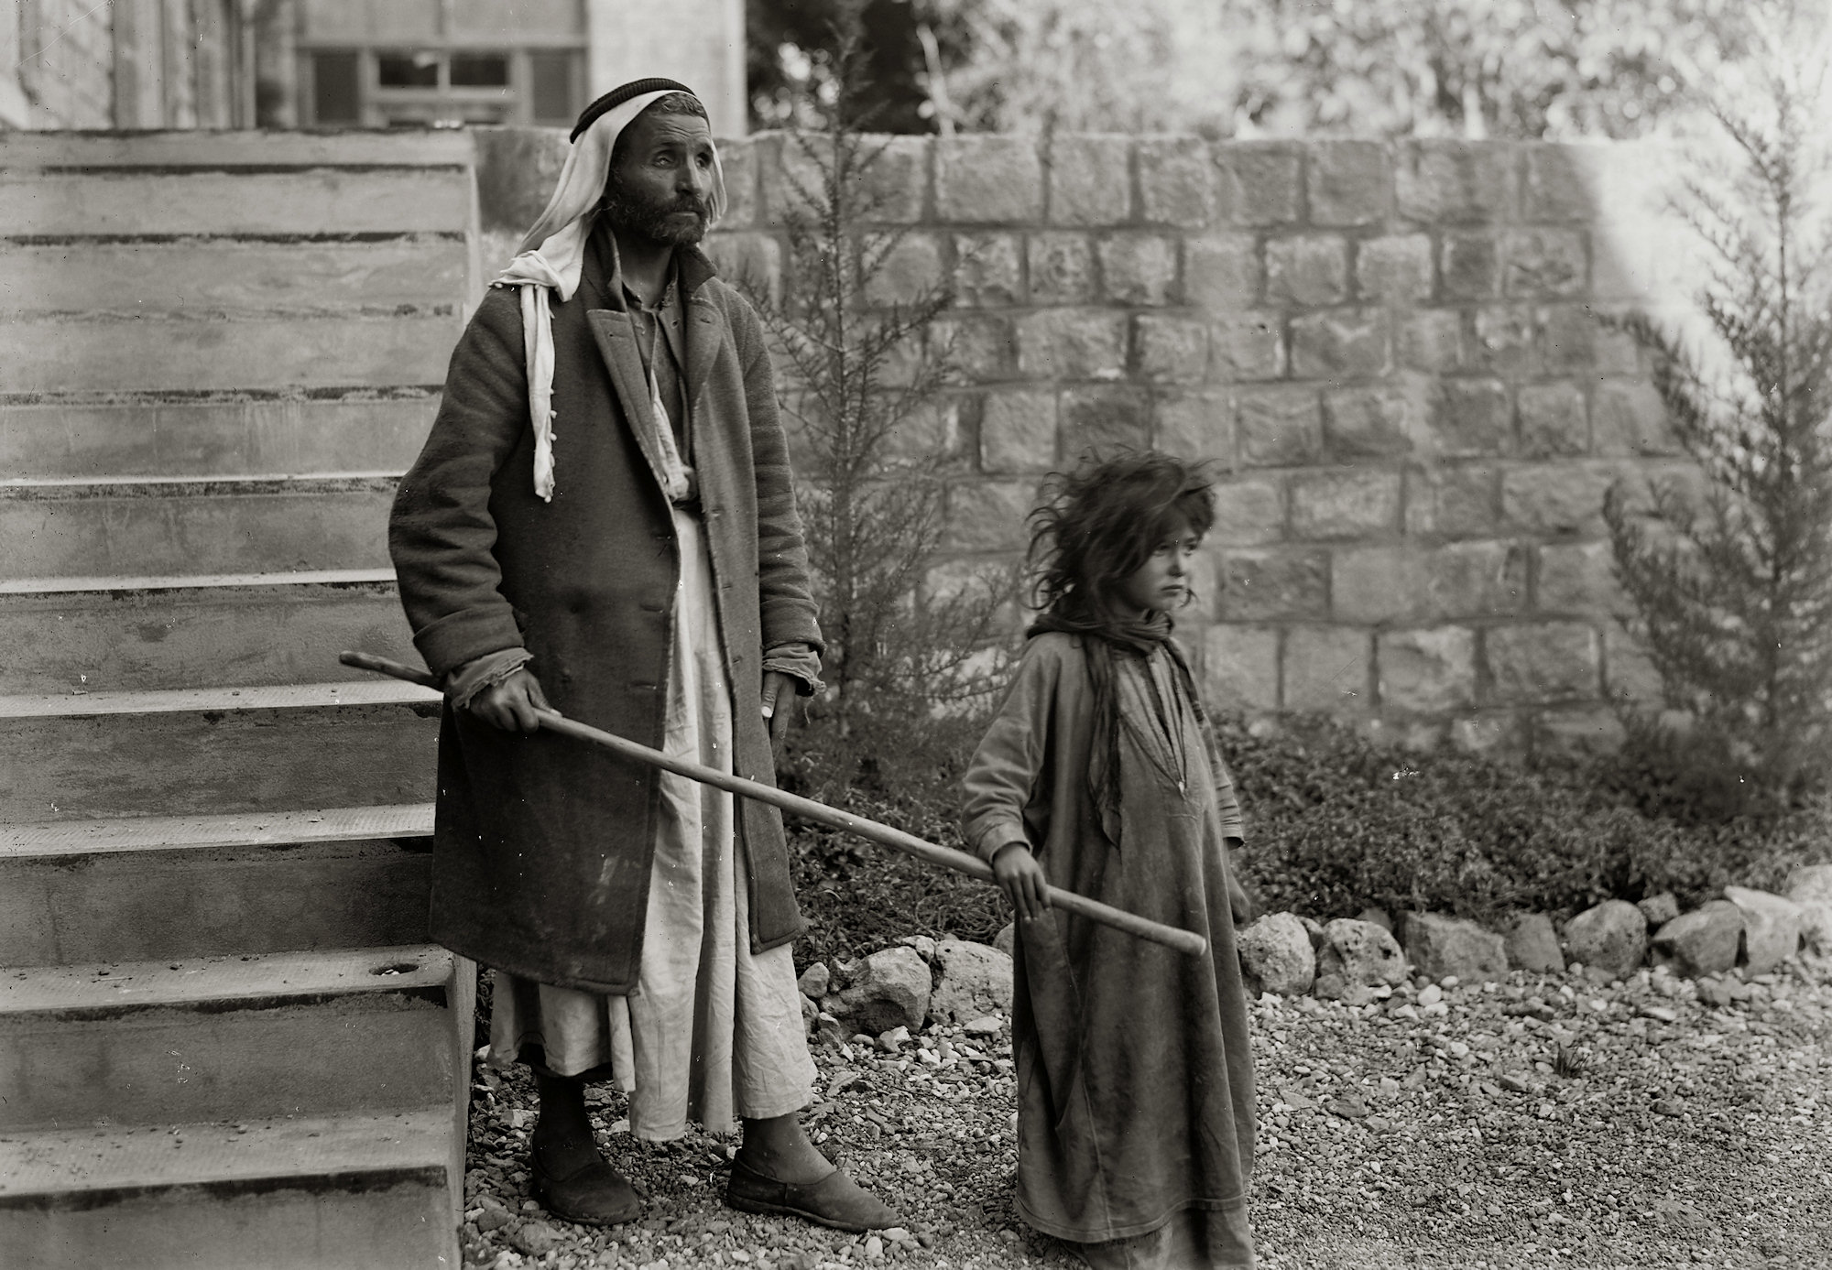
Eric Matson Collection; published by Todd Bolen / LifeintheHolyLand.com

Slide 3
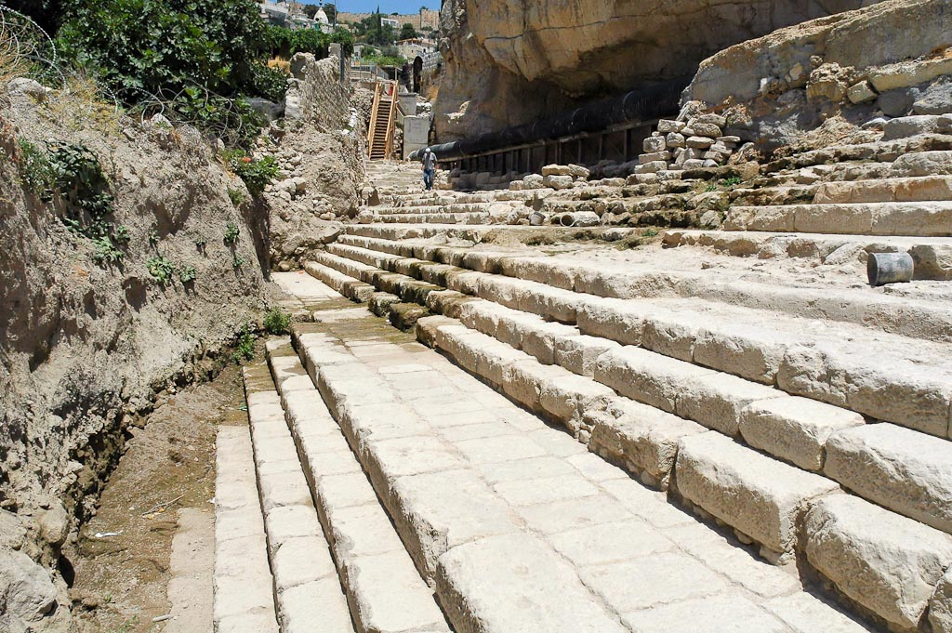
Pool of Siloam excavations: size of the pool possibly seventy yards long!
Photo © Todd Bolen / bibleplaces.com

Slide 4
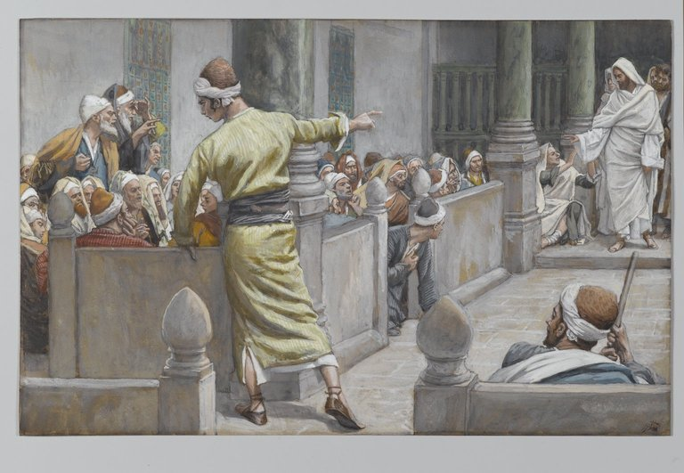
The healed man testifies as portrayed by James Tissot / courtesy of BrooklynMuseum.org

Slide 5
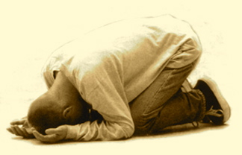
προσκυνέω = “I Worship” in the sense of prostrating myself in an attitude of dependence and submission

Slide 6
1. Judah will fall into exile by Babylon because of failure of Davidic Kings.
2. Jews will receive deliverance through an Ultimate Davidic King, the Servant of Yahweh, who will substitute for their sins.
3. Jews are blind to God’s truth, but Ultimate Davidic King will deliver them to relationship with God while reversing the curse.
Isaiah
≈ 700 years before Christ

